Slide 1
SPlashy

Slide 2
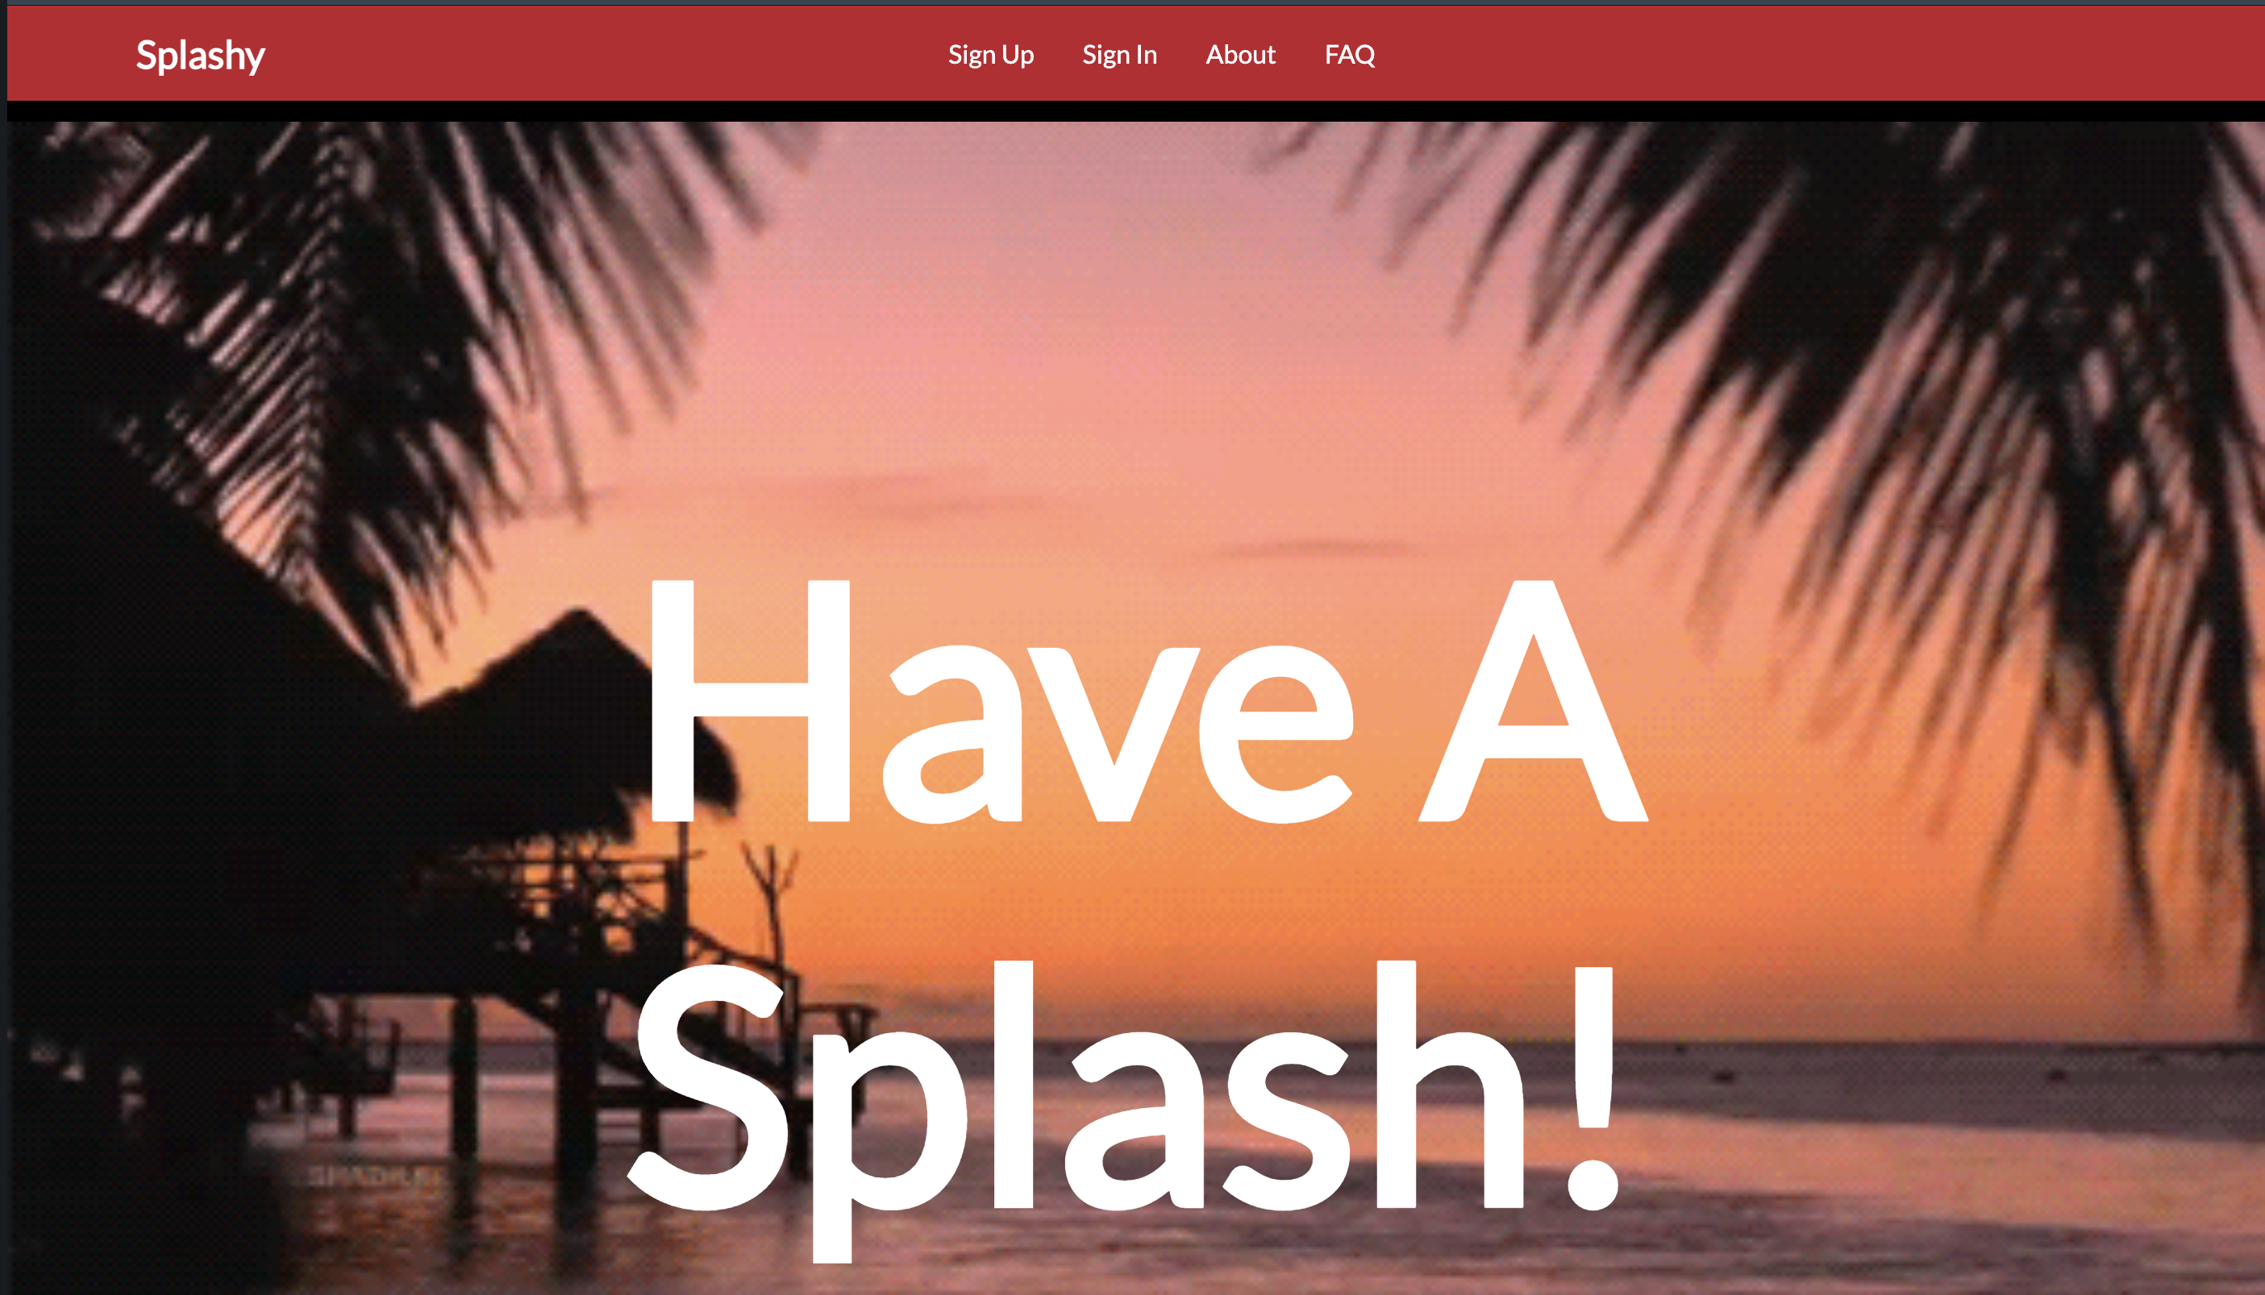
OUR project
Show and explain your web, app or software projects using these gadget templates.

Slide 3
✋👆👉👍👤👦👧👨👩👪💃🏃💑❤😂😉😋
😒😭👶😸🐟🍒🍔💣📌📖🔨🎃🎈🎨🏈🏰
Team Members
Samantha Reindorf
Hamed Traore
Rodney Nayo
Nana Yaw Adjei Koranteng

Slide 4
1.
Background
Target Market , Purpose, Product & Services , Functionalities

Slide 5
Service & Target Market
Splashy is a social media made for Ashesi students and faculty. The web app is designed to help build stronger relationships between students and faculty through the sharing of media as well as helping to make their life in Ashesi easier and more comfortable with the services it provides.

Slide 6
PURPOSE
To help build faculty and student relationships
To give students information of clubs and events in the school
To give students easy access to facilities such as joining clubs and registering for events among others
To help faculty easily setup events in the school

Slide 7
Operations/ Functionalities
Students
They can make posts
They can meet with club heads
They can register for events that have been posted
They can access educational resources provided by faculty
Interact with the in built chatbot
Faculty
They post/edit/delete events
They can upload educational resources
Interact with the in built chatbot.

Slide 8
2. Architecture & design
3-tier Architecture, Layers of implementation

Slide 9
3-Tier Architecture
Presentation Tier
For this part html, CSS and JavaScript where used to create the interface seen by the user.
This is controlled mainly by the logic tier using php.
Logic Tier
Php was used to design this tier.
This tier controls most of the operations of the website
This tier also create the connection to the database
Data tier
MySQL and phpMyAdmin were used for this section
This is the layer that stores user information and other necessary information

Slide 10
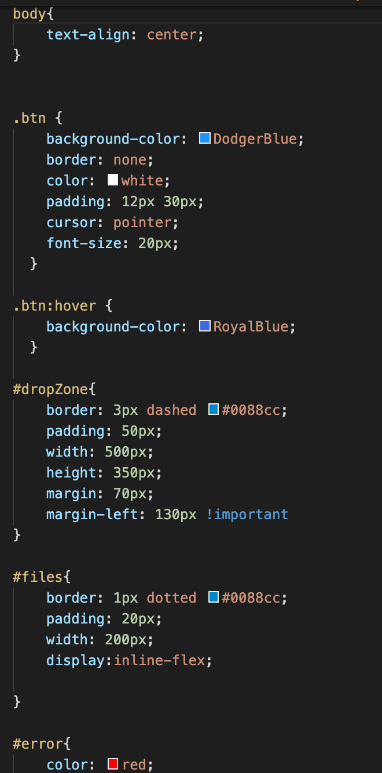
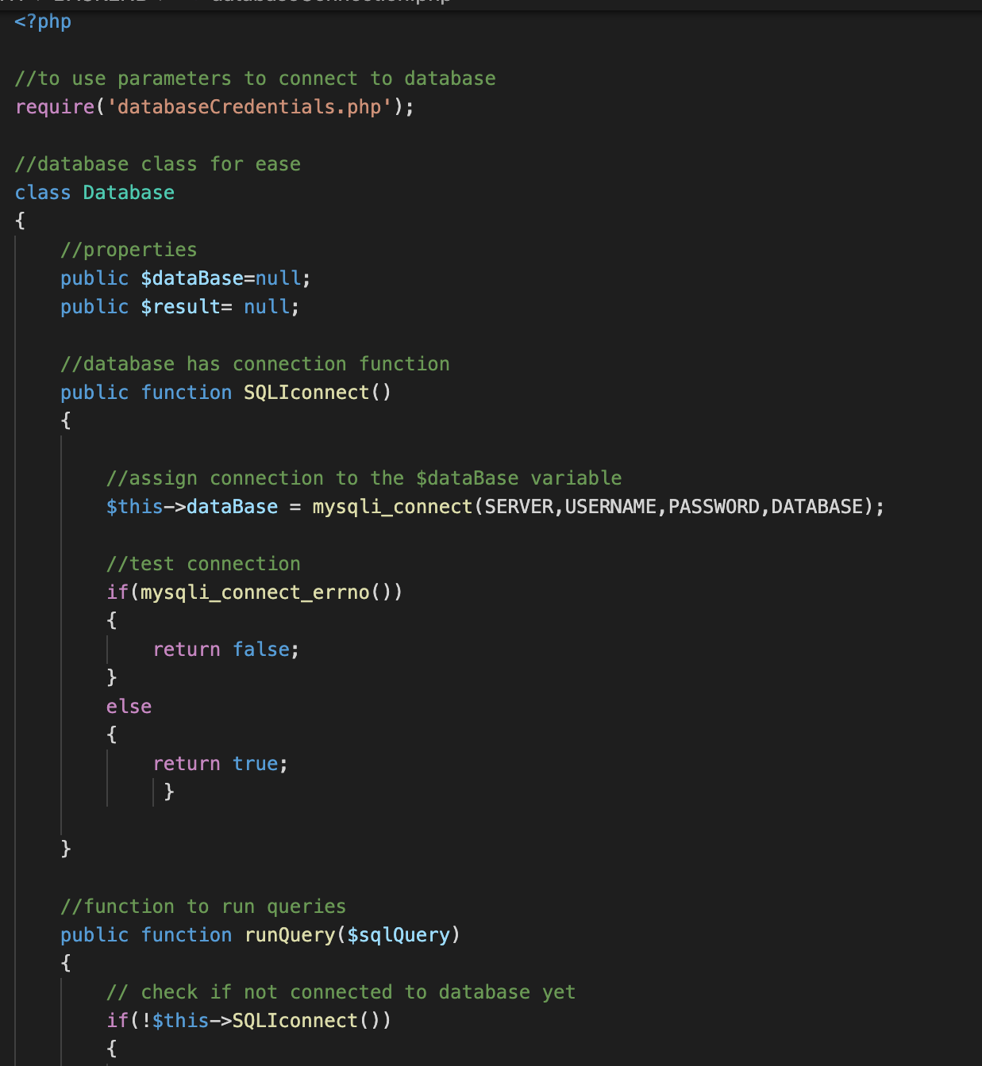
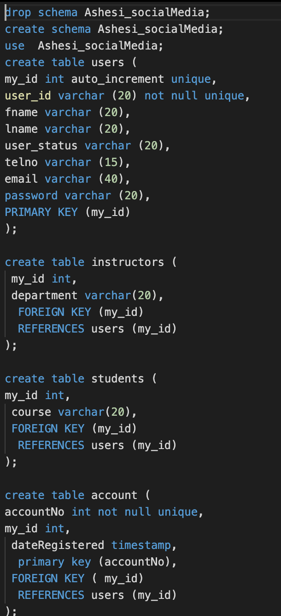
3-Tier Architecture
Presentation tier
Logic tier
Data tier

Slide 11
3. IMPLEMENTATION
Tools, Flowchart, classes, libraries, framework, APIs,
Demonstrate each member participation
Screenshot or snippet of codes

Slide 12
Implementation
Libraries
Font Awesome for some styles
Emoji library to be used in post section
Frameworks
Bootstrap for creating objects such as the nav bar and also for styling
Classes
We created a Database class to control reading and saving to the database
We created an event class events to control the creation, update and deletion of events

Slide 13
Member Participation
Samantha -> Front & back end for the pages such as the club and event pages among other things
Rodney -> Front end for pages such as the home page, index page and creation of forms such as the login in and sign up forms among other things
Hamed -> Backend for for the log in and sign up pages as well as the backend for making posts among other things
Nana Yaw -> Database design, chatbot frontend and backend and backend for post

Slide 14
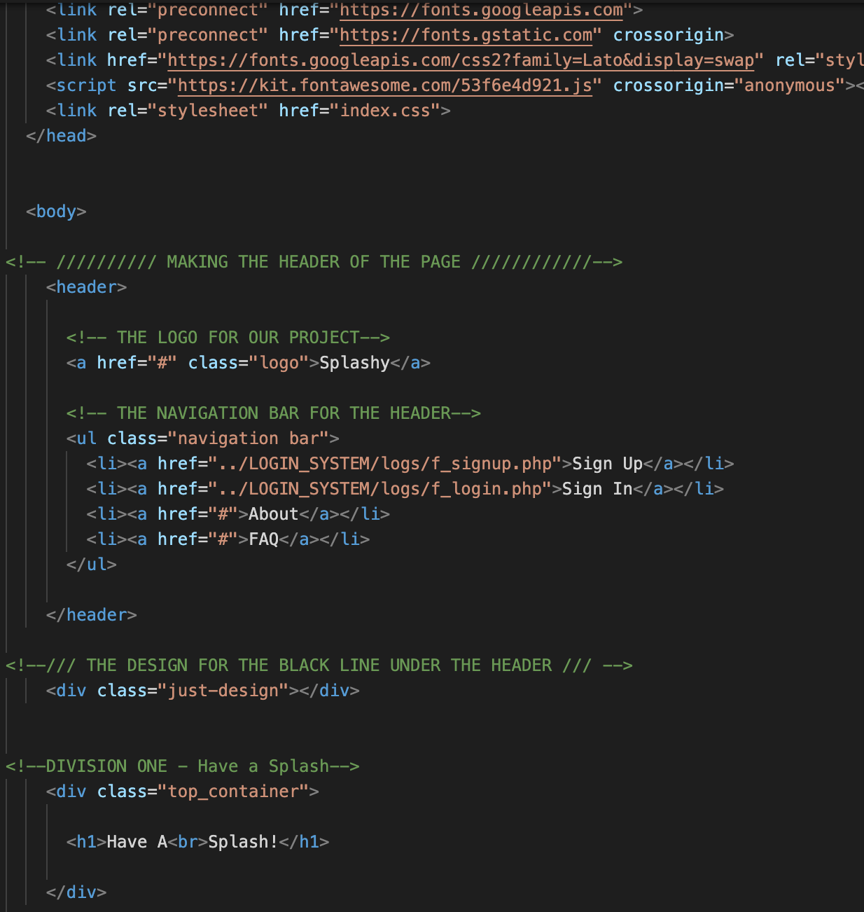
Screenshots

Slide 15
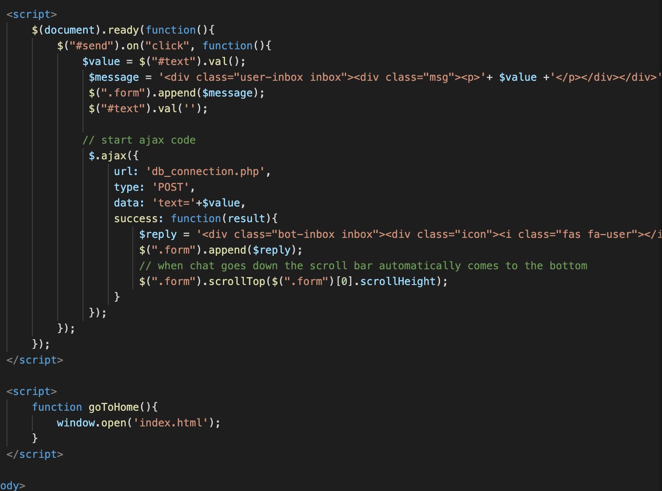
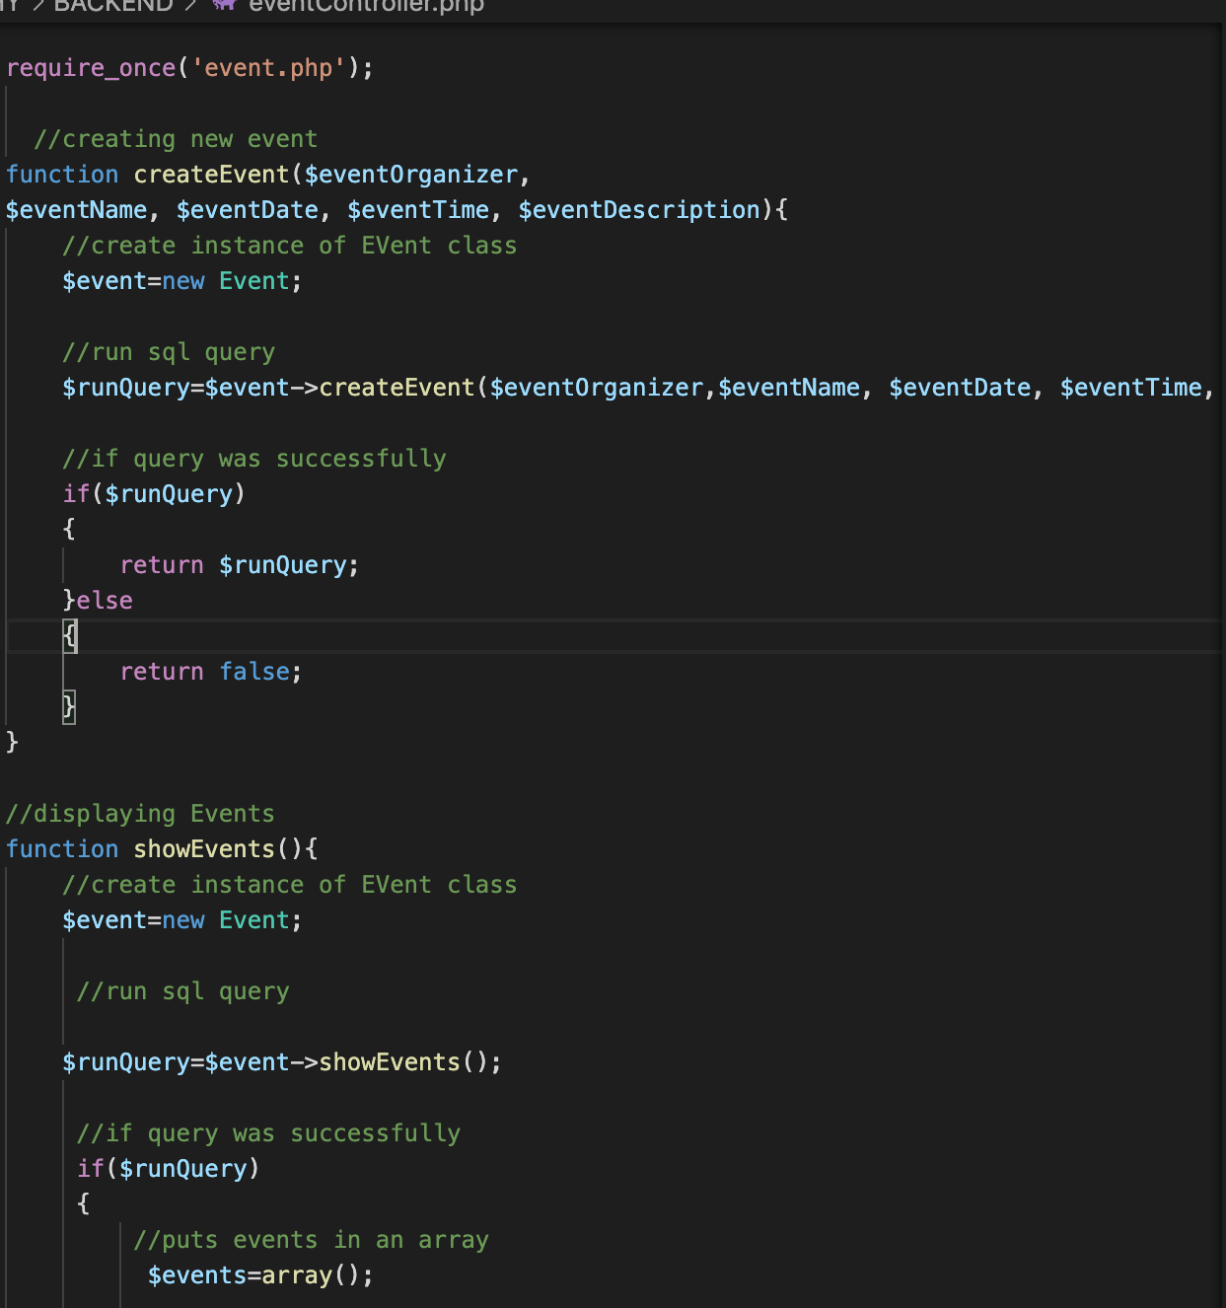
Screenshots

Slide 16
4. DEMO & TESTING
Testing Website experience

Slide 17
Thanks!
No questions please?

